Slide 1
Canada’s Path Towards Broad Access to Medical Assistance in Dying (MAID)
Trudo Lemmens, Professor & Scholl Chair in Health Law & Policy Faculty of Law & Dalla Lana School of Public Health
University of Toronto
Jersey assisted dying
citizens’ jury
March-May 2021

Slide 2
Canada: Overview Developments
Safeguards (including Broad Access Criteria)
Expansion outside end-of-life context: Rights Rhetoric & court challenge
Reduction Safeguards in New Bill 2021
Data: sense of being burden, loneliness, inadequate palliative care/health care & disability supports factors in some/many MAID requests

Slide 3
Key Safeguard: Access Criteria
b) irreversible decline in capability
c) intolerable suffering : entirely subjective
d) Reasonable Foreseeable Natural Death [RFND]: broad ‘end-of-life’ context

Slide 4
Other Safeguards
Written Request + 2 witnesses (reduced to 1 under new Bill)
Assessment 2 physicians/nurse practitioners
10 day-reflection & reconfirmation consent (abolished under new Bill)
Regulations data gathering: broad, not ‘fine-grained’ data

Slide 5
Rhetoric Post-Carter
Presumption of broad “Right to Physician Assisted Dying/ Medical Assistance in Dying” [imho: not in line w Carter]
Pressure to expand MAID outside end-of-life context: lobbying, media reporting, even health professional organisations embracing ‘rights rhetoric’ & necessity of expansion outside end-of-life context

Slide 6
Truchon v Canada AG (Que Superior Court 2019)
‘Restriction’ Reasonable Foreseeable Death = violation of Charter rights to Life, liberty, Security of person & Equality
Decision not appealed: government introduced Bill C-7 to expand access 2020

Slide 7
NEW Bill C-7: 2-Track System
TRACK 1: Reasonable Foreseeable Death: reduction safeguards
10 day reflection abolished
1 witness
Limited AR MAID
TRACK 2: People not ‘approaching natural death’ (not RFND)
90-day assessment period (can be shortened)
1 assessor w expertise medical condition that causes suffering
Additional informed consent measures
Offer of counselling
Confirmation of ‘serious consideration’ of other options
Mental Illness: to be introduced in 2 years
No obligations other reasonable options tried/exhausted first

Slide 8
Bill C-7: Discrimination + Violation Right to Life
Removal of ‘RFD’ (end-of-life) safeguard singles out persons w disabilities for fast-track to death: only they have access to MAID outside end-of-life context
3 United Nations Special Rapporteurs/Human Rights Experts: Expression of ’Grave Concern’ to Canada
Some legal scholars (incl. me), all major disability rights org’s, many MH professionals, suicide experts: objections against Bill

Slide 9
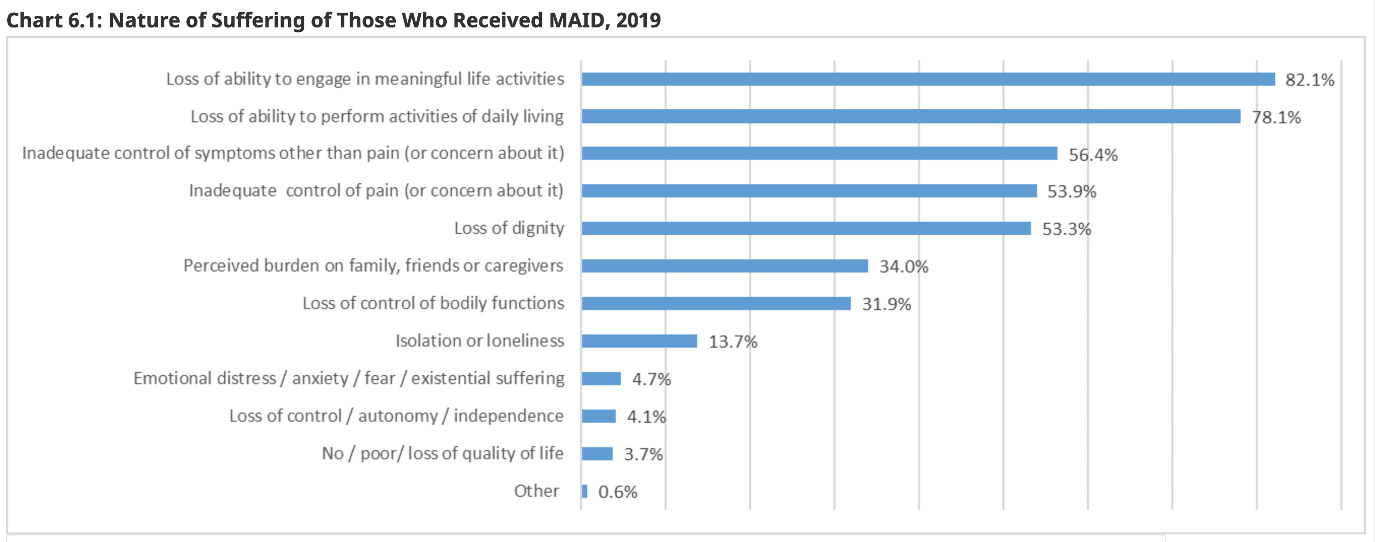

Slide 10
Palliative Care & Disability Supports
Health Canada Data: “82.1 % received palliative care”; “89.8% disability support services”
Self-reported data by providers
No detailed information exactly when, why, how, quality of palliate care
STILL: Palliative Care: 19% < 2 weeks = questions about timely, quality palliative care
Competing independent studies on access palliative care
Downar et al, CMAJ 2020: 77% palliative care; higher income category; no concerns
Munroe et al. Can Fam Phys 2020:
“gap in the provision of palliative care among the patients who requested MAID.”
“39.3% no previous palliative care involvement”
Anecdotal Reports of People already requesting access to MAID for economic hardship, isolation during pandemic
Notes:
Official Data: NUMBER OF PEOPLE With inadequate palliative care: perhaps . 900!
DATA about DISABILITY SUPPORTS and problems ACCESS TO HEALTH CARE
EXAMPLE: 40,000 elderly on wait list for access to LTC homes
HUMAN RIGHTS COMPLAINTS by elderly rights organizations against Ontario

Slide 11
Conclusion Canada
Safeguards (inc. Broad Access criteria RFD)
Expansion MAID outside end-of-life context: “Rights Rhetoric”, media reports, court cases: many more will have access to MAID w New Bill: impact disabled persons
Social determinants health and limits health care & disability supports appear to contribute to MAID requests
Limits of Data

Slide 12
Sources
Health Canada, First Annual Report on Medical Assistance in Dying in Canada (2020): https://www.canada.ca/en/health-canada/services/medical-assistance-dying-annual-report-2019.html#chart3.1
Trudo Lemmens, Heeso Kim, Elizabeth Kurz, “Why Canada’s Medical Assistance in Dying Law Should be C(h)arter Compliant and What it May Help to Avoid” (2017) 11(1) McGill Journal of Law & Health S61-S148; online: https://mjlh.mcgill.ca/publications/volume-111/why-canadas-medical-assistance-in-dying-legislation-should-be-charter-compliant-and-what-it-may-help-to-avoid/
Trudo Lemmens, Mary Shariff & Leonie Herx, ”How Bill C-7 will sacrifice the medical profession’s Standard of Care” (11 February 2021) Policy Options https://policyoptions.irpp.org/magazines/february-2021/how-bill-c7-will-sacrifice-the-medical-professions-standard-of-care/

