Slide 1
Hospital Policy Board
Workshop 3
7th August 2018

Slide 2
Feedback previous Workshop
Site selection process Urban v Rural
Further info on: Transport issues, blue light responses
Removal of dual site option
Further info on: n/a
Current site selection
Further info on: Economic Advice (Waterfront), Covenant (People’s Park)

Slide 3
Approved site selection options

Slide 4
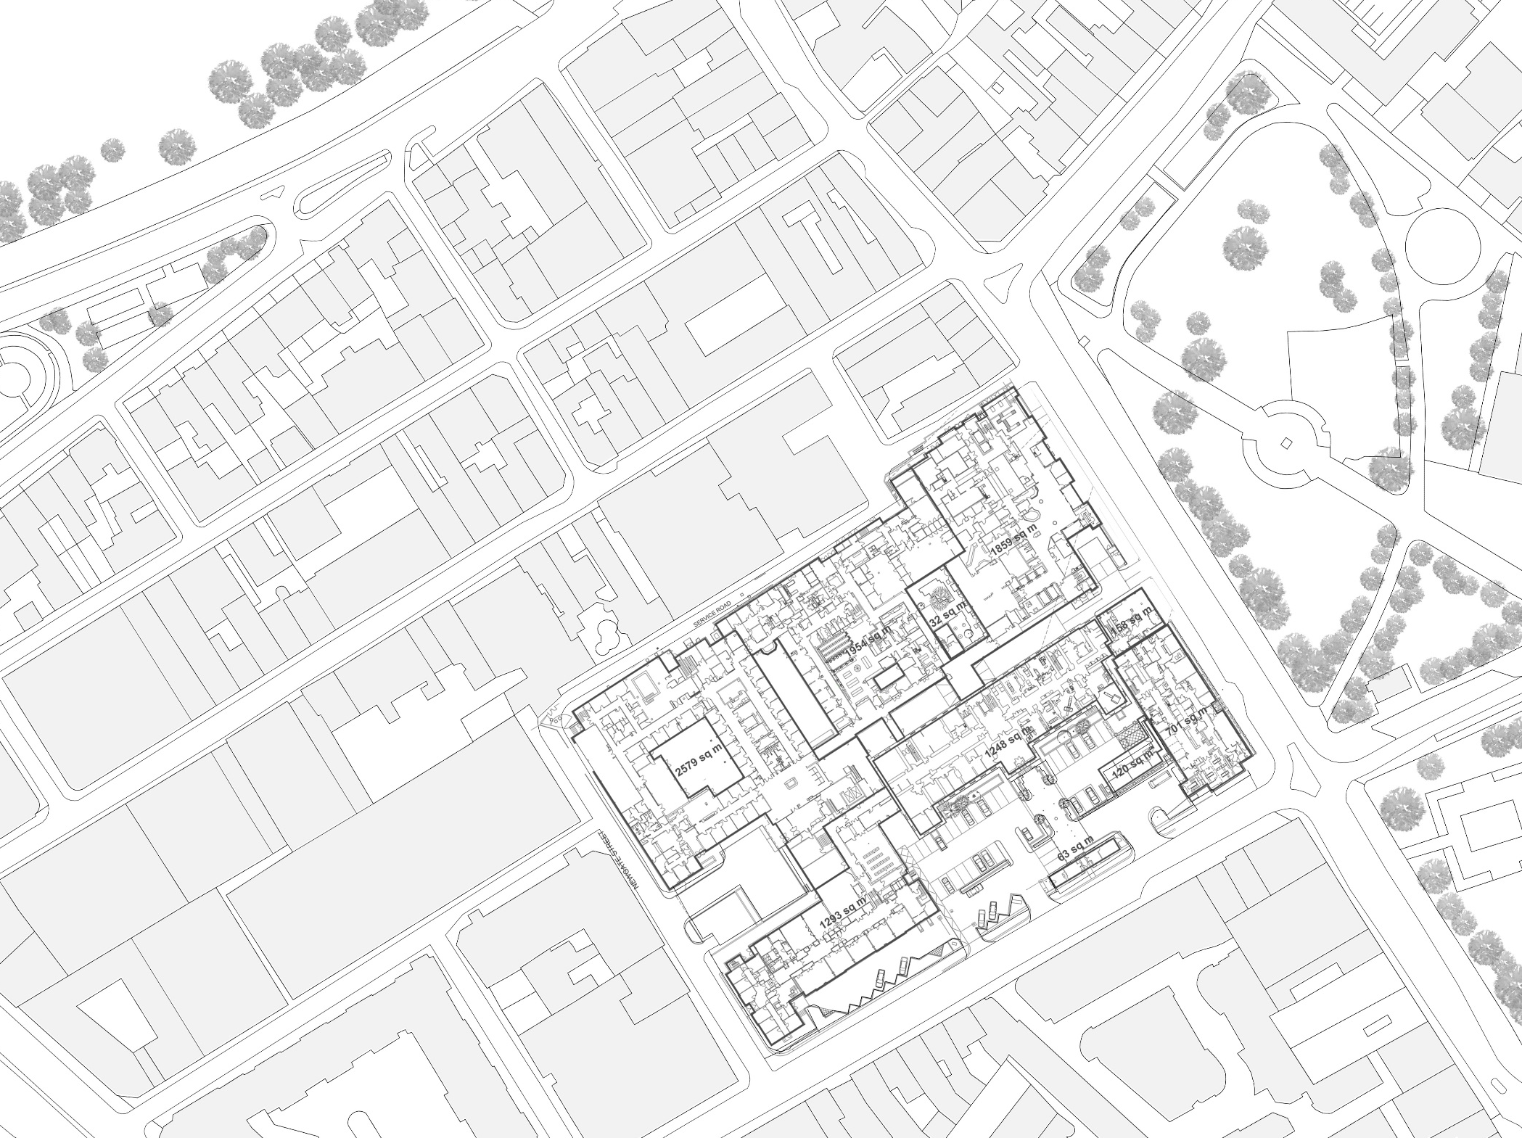
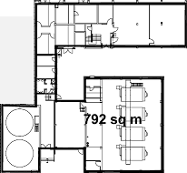
Existing General Hospital

Slide 5
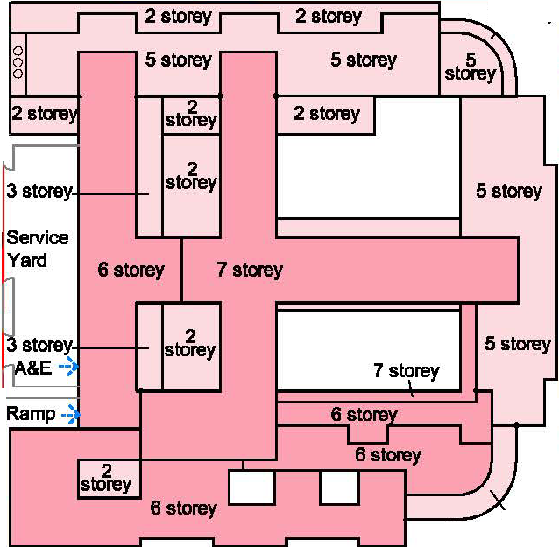
2013 “Option 1E”
Granite Block refurbished (some clinical space)
Peter Crill House demolished
1980’s Block demolished
1960’s Block demolished
Hotels purchased
2&4 Edward Place purchased
£461m
11 year programme

Slide 6
2015 “Option C”
Granite Block refurbished (some clinical space)
Peter Crill House retained
1980’s Block demolished
1960’s Block demolished
Hotels purchased
2&4 Edward Place purchased
£626m
11.5 year programme
2 storey
4 storey
2 storey
5 storey
6 storey
4 storey
7 storey
4 storey
2 storey

Slide 7
Westaway Court
2016 “Option F” –
2017 outline planning application
Granite Block refurbished (no clinical space)
Peter Crill House demolished
1980’s Block retained
1960’s Block retained
Boiler house retained
Hotels purchased
36-44 Kensington Place purchased
Westaway Court included
Temporary works required
£466m
8 year programme
9 storey
4 storey
9 storey
4 storey

Slide 8
Westaway Court
2018 “Revised scheme” -
outline planning application
Granite Block refurbished (no clinical space)
Peter Crill House demolished
1980’s Block demolished
1960’s Block demolished
Boiler house demolished
Hotels purchased
36-44 Kensington Place purchased
Westaway Court rebuilt
£466m
8 year programme (from Q4 2016) +2 years for Granite Block and new main entrance
3 storey
3 storey
4 storey
6 storey
4 storey
3 storey

Slide 9
Jersey Future Hospital
Acquire & demolish Kensington Place properties
Provide temporary/permanent plant zones to maintain services to existing
Demolish existing energy centre
Construct Block A
Construct Westaway Court
Construct Temporary Link from 80’s block to Block A
Decant all services (in Gwyneth Huelin and central laboratory block) into Block A and Westaway Court
Westaway Court
A
Temporary link
from existing 80s
Block to Block A

Slide 10
Jersey Future Hospital
Demolish Gwyneth Huelin Wing, Peter Crill House and central Laboratory Block
Construct Block B
Decant existing facilities from remainder of existing hospital into Block B
Provide temporary entrance to new hospital
Westaway Court
Phasing
Phase 1b
A
B
Temporary link
from existing 80s
Block to Block A

Slide 11
Jersey Future Hospital
Demolish 80’s and 60’s Blocks
Construct Block C
Refurbish Granite Block
Westaway Court
Phasing
Phase 2
C
A
B
Temporary link
from existing 80s
Block to Block A

Slide 12
Site design evolution

Slide 13
Planning challenges

