Slide 1
An Overview of Assisted Dying in Canada
Jocelyn Downie, CM, FRSC, FCAHS, SJD
James S Palmer Chair in Public Policy and Law, Schulich School of Law, University Research Professor, Dalhousie University
Jersey assisted dying
citizens’ jury
March-May 2021

Slide 2
Key Points
The journey to legislation
Country-specific language/terminology
Eligibility criteria (up to March 17, 2021)
Data
Learnings
Jersey assisted dying
citizens’ jury
March-May 2021

Slide 3
The journey
Carter v. Canada (SCC 2016)
  prohibition on MAiD struck down for persons with grievous and irremediable medical condition causing enduring suffering that is intolerable to the person (where irremediable does not require that the person undertake treatments that are unacceptable to them)
Canada (Attorney General) v. EF (Alta CA 2016)
  Persons with a psychiatric illness are not explicitly or inferentially excluded from Carter declaration if they meet the criteria

Slide 4
The destination
Bill C-14 (2016)
  Blanket prohibition on MAiD removed from Criminal Code but narrower eligibility criteria than Carter

Slide 5
Eligibility criteria (1-5/6)
Eligibility for government-funded health services
At least 18 years of age
Capable of making decisions with respect to health
Voluntary request for MAiD not made as a result of external pressure
Give informed consent to receive MAiD after having been informed of means available to relieve their suffering, including palliative care

Slide 6
Eligibility criteria (6/6)
6. Grievous and irremediable medical condition
  Serious and incurable illness, disease or disability
  Advanced state of irreversible decline in capability
  Illness, disease or disability or state of decline causes enduring physical or psychological suffering that is intolerable to them and that cannot be relieved under conditions that they consider acceptable

Slide 7
Eligibility criteria (continued)
  d. Natural death has become reasonably foreseeable, taking into account all of their medical circumstances, without a prognosis necessarily having been made as to the specific length of time that they have remaining

Slide 8
Canada-specific terminology
“Medical assistance in dying” (“MAiD”)
  Provider-administered assisted dying
  Self-administered assisted dying
“Natural death has become reasonably foreseeable”
  Sufficient temporal proximity (multiple years) OR
  Predictable trajectory (e.g., ALS diagnosis) OR
  Certain intent to stop preventive care and refuse treatment (e.g., BiPap machine and antibiotics)

Slide 9
Key data
Situation in Canada

Slide 10
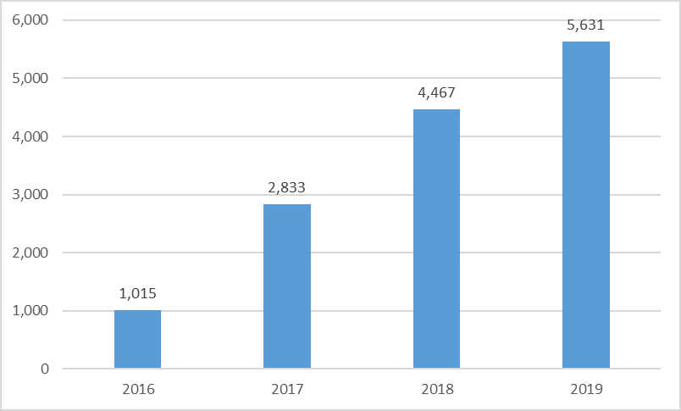
Chart 3.1: Total Reported MAID Deaths in Canada, 2016 to 2019

Slide 11
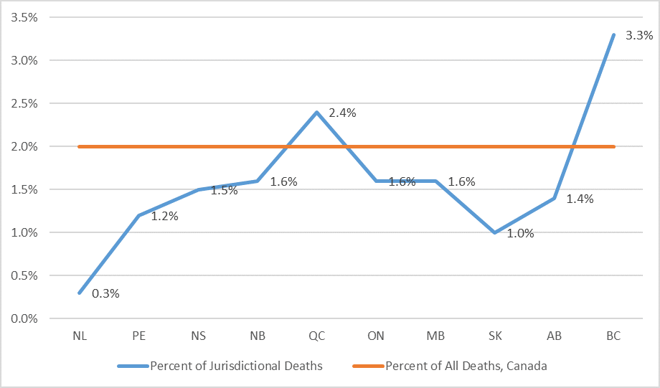
Chart 3.2: Percentage of Total Deaths Attributed to MAID by Jurisdiction, 2019

Slide 12
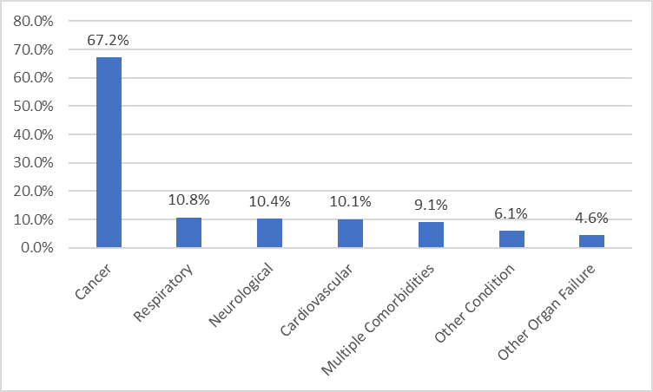
Chart 4.1: MAID by Main Condition, 2019

Slide 13
Demographics
50.1% men 49.9 % women
Average age 75.2

Slide 14
Chart 4.2: MAID by Age Category, 2019

Slide 15
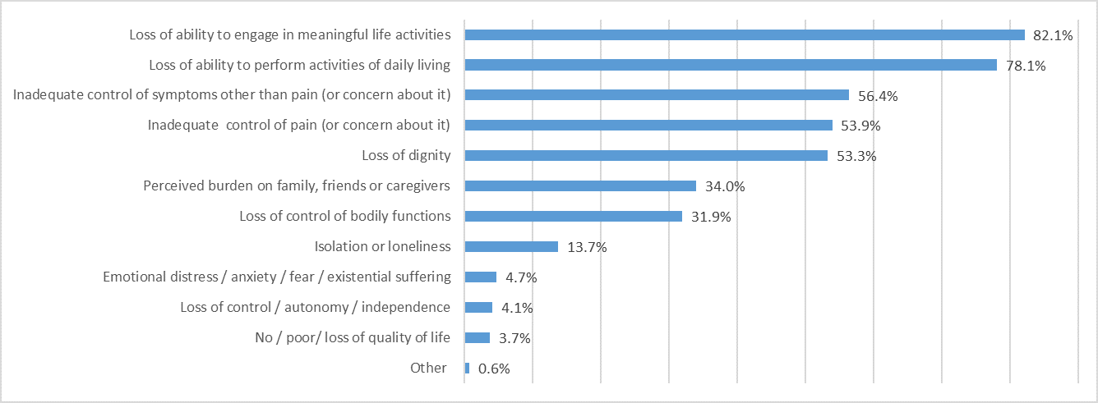
Chart 6.1: Nature of Suffering of Those Who Received MAID, 2019

Slide 16
Palliative care and disability support services
Palliative care services
Disability supports
Received 82.1%
Didn’t receive 16.2%
Accessible if needed 89.6%
Required 41.2%
Didn’t require 42%
Received 89.8%
Required but didn’t receive 3.9%

Slide 17
Reasons for ineligibility for MAiD
Not capable of making decisions with respect to health 32.2%
Natural death not reasonably foreseeable 27.8%
Not in an advanced state of irreversible decline in capability 23.5%
Not experiencing suffering that is intolerable to them 17.7%
Could not provide informed consent 17.0%
Did not have a serious and incurable illness, disease or disability 13.3%
Request was not voluntary 1.6%

Slide 18
Learnings (mistakes 1)
Define your terms (e.g., “reasonably foreseeable”)
Be clear on rules re: conscientious objection (individual provider and institutions)
Ensure required drugs are approved and available

Slide 19
Learnings (mistakes 2)
Be clear on whether clinicians can inform patients re: MAiD without being asked
Requirement of express consent immediately prior to provision leads to people accessing MAiD earlier than they otherwise would

Slide 20
Learnings (went well 1)
Clinicians will step up and build community to share best practices and support each other
Good to have physicians and nurse practitioners
Our eligibility criteria (except “reasonably foreseeable”) work to protect autonomy and prevent suffering without allowing for access to MAiD where not free and informed and made by a competent individual

Slide 21
Learnings (went well 2)
No slippery slope
Patients (and their families) benefitted
  Knowing it’s there
  Accessing it

Slide 22
Key Points Redux
The journey to legislation
Country-specific language/terminology
Eligibility criteria (up to March 17, 2021)
Data
Learnings
Jersey assisted dying
citizens’ jury
March-May 2021

Slide 23
Jersey
assisted dying
citizens’ jury
March-May 2021

