Slide 1
An overview of medical eligibility criteria
Professor Rob George MA MD FRCP FRCGP Hon
Medical Director St Christopher’s Hospice London
Professor of Palliative Care, Cicely Saunders’ Institute King’s College London
Jersey assisted dying
citizens’ jury
March-May 2021

Slide 2
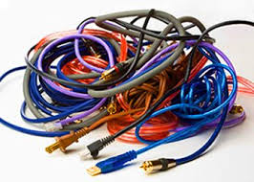
An exceptional tangle
Two overall questions
Four specific question
Is it right for society to legalise assisted suicide or euthanasia – (if it is confined to the dying)?
Who should do it?
  the link to dying means we assume them to be doctors
  on the evidence this is the worst option
What do we mean by dying?
Are pain, suffering and intolerability important & feasible criteria?
What about mental states?
What about discrimination and vulnerability?

Slide 3
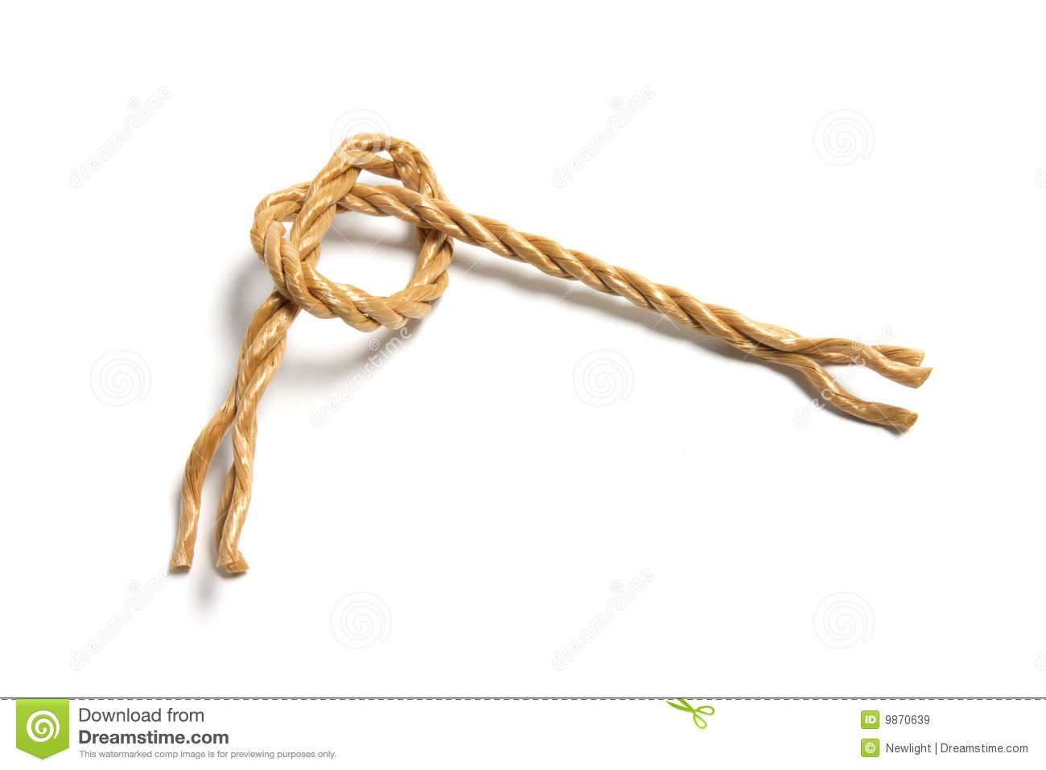
What do we mean by dying?
Diagnosis - “what” – probability, not certainty
  About 1:20 post mortems show treatment was for the wrong condition
  I and my colleagues see people every year, labelled as dying, who are curable
Prognosis - “when” – is only guesswork
  Days to weeks? we’re reasonable
  Weeks to months? we’re hopeless
  A prognosis of 6 months without treatment (Oregon) is almost a ‘catch-all’
Jersey assisted dying
citizens’ jury
March-May 2021
Notes:
DIAGNOSIS
Post mortem studies reveal 30% errors on death certificates
5% have led to wrong treatments
In the old Loneliness leads to death quicker, doers that make it a legitimate reason to end life?
Holland has engaged this question
PROGNOSIS
Oregon have resolved their problem with underestimating prognosis (up to 4 years)
It is now prognosis of the untreated disease – i.e. controllable diseases such as diabetes etc. are now classifiable as terminal irrespective of age, health etc.

Slide 4
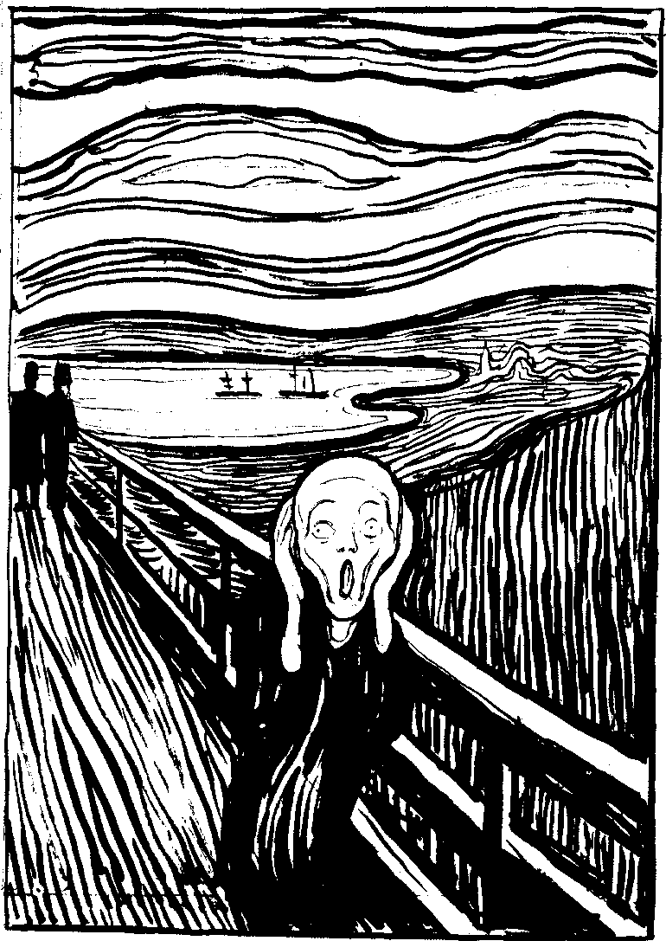
Pain & Suffering: biography, not biology & entirely subjective
“Pain and suffering is what someone says it is”
“The sheer bloody agonies of existence”
“I am not a mechanism, an assembly of various sections.
“And it is not because the mechanism is working wrongly…
“I am ill because of wounds to the soul, to the deep emotional self” (DH Lawrence)
unbearability?
Doctors decide, not patients
Notes:
These are social issues – values and not facts:
Issues of relationship, helplessness, meaning
In palliative care what we call total pain
There is a massive literature
Complex relationship between physical emotional social psych and spiritual
Influences of family distress, transference and countertransference
Munck was a very complex character with childhood grief and an obsession with death

Slide 5
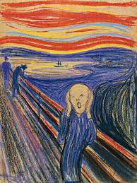
Mental States: both fragile & subtle
How people see things, and why, is both complex and unique
Mental Capacity
– the ability to retain, understand, reason and communicate
Mental Illness/disorder
– any disorder or disability of the mind
Demoralisation Syndrome
  a distorted view of life based on assumptions, experience etc.
Notes:
https://www.researchgate.net/publication/12012374_Demoralization_syndrome-A_relevant_psychiatric_diagnosis

Slide 6

Discriminations are intolerable:
If assistance to die is allowed for one person, why not any person?
Why do you get this just because you are dying, but I can’t because I’m not?
What makes your pain or suffering worse than mine?
Is my mental suffering not just as real and unbearable as your cancer pain?
If I dement, I will already be dead to who I was, so why keep me alive?
Inevitably, restrictive
criteria must loosen and extend. Every legislature shows that
Notes:
Society’s default. Now is to people’s rights
Doctors respond to this because we default to people’s best interests
We worry most about the incapacitous person and once we have the power to judge whether a life is worth living, we begin to behave that way
This is evidence in Holland and Belgium especially, but other legislatures are experiencing these pressures
Legislatures are very unlikely to censure doctors interpreting the guidance or violating it.
Details
You may eb interested in www.apmonline.org: search under assisted dying 2020 and follow the links to “are safeguards sufficient”. It refers to the wxtension to those with mental health prblems, autism, dementia and the minors
https://kadoh.uk/evidence/ gives a succinct summary in its synthesis of evidence.

Slide 7
Drawing things together
Initial Questions
Conclusions about them
What do we mean by dying?
What about mental illness and mental capacity?
Are pain, suffering and intolerability important criteria?
What about discrimination and vulnerability?
The complexity of dying & mental ill-health evade meaningful legal definition
Doctors default to a blend of their patient’s and their own views of best interest that are too open to error and abuse
Narrow, generalised restrictions will produce unsustainable discrimination

Slide 8
Stark realities from these uncertainties:
My reading of the evidence is that ‘medical’ criteria adjudicated by doctors cannot work safely
“Laws, like nation states, are more secure when their boundaries rest on natural frontiers. …
“The law is there to protect us all”
which is worse -
  Not to kill people who want to die?
  To kill people who might want to live?
Jersey assisted dying
citizens’ jury
March-May 2021

Slide 9
My Opinion
Concerns:
An alternative:
The complexity of dying & mental ill-health evade meaningful legal definition
Doctors default to a blend of their patient’s and their own views of best interest that are too open to error and abuse
Narrow, produce unsustainable discrimination
Uncouple lethal solutions from health care altogether
Individualise cases through a judicial vs medical process
Have a separate system of practitioners directly accountable to the court
Confine doctors to what they do best: care
Secure adequate specialist palliative care & mental health services before legislating for assisting people to die

