Slide 1
assisted death legal eligibility criteria an introduction
Isra Black
York Law School, University of York

Slide 2
plan
assisted death legal eligibility criteria
  broad sense
  narrow sense
eligibility criteria unpacked
  autonomy
  age
which eligibility criteria and why?

Slide 3
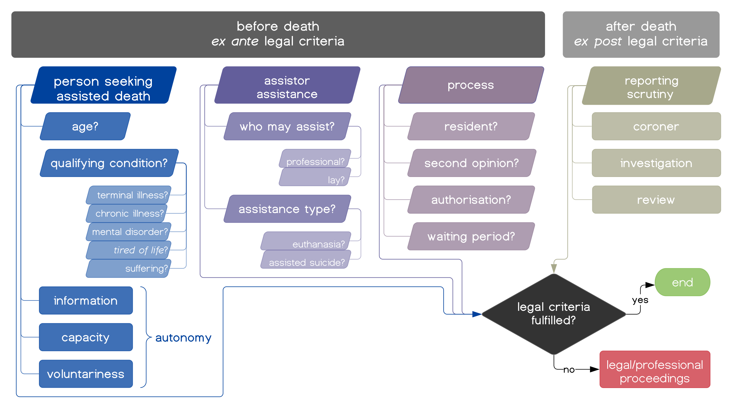
assisted death eligibility criteria broad sense

Slide 4
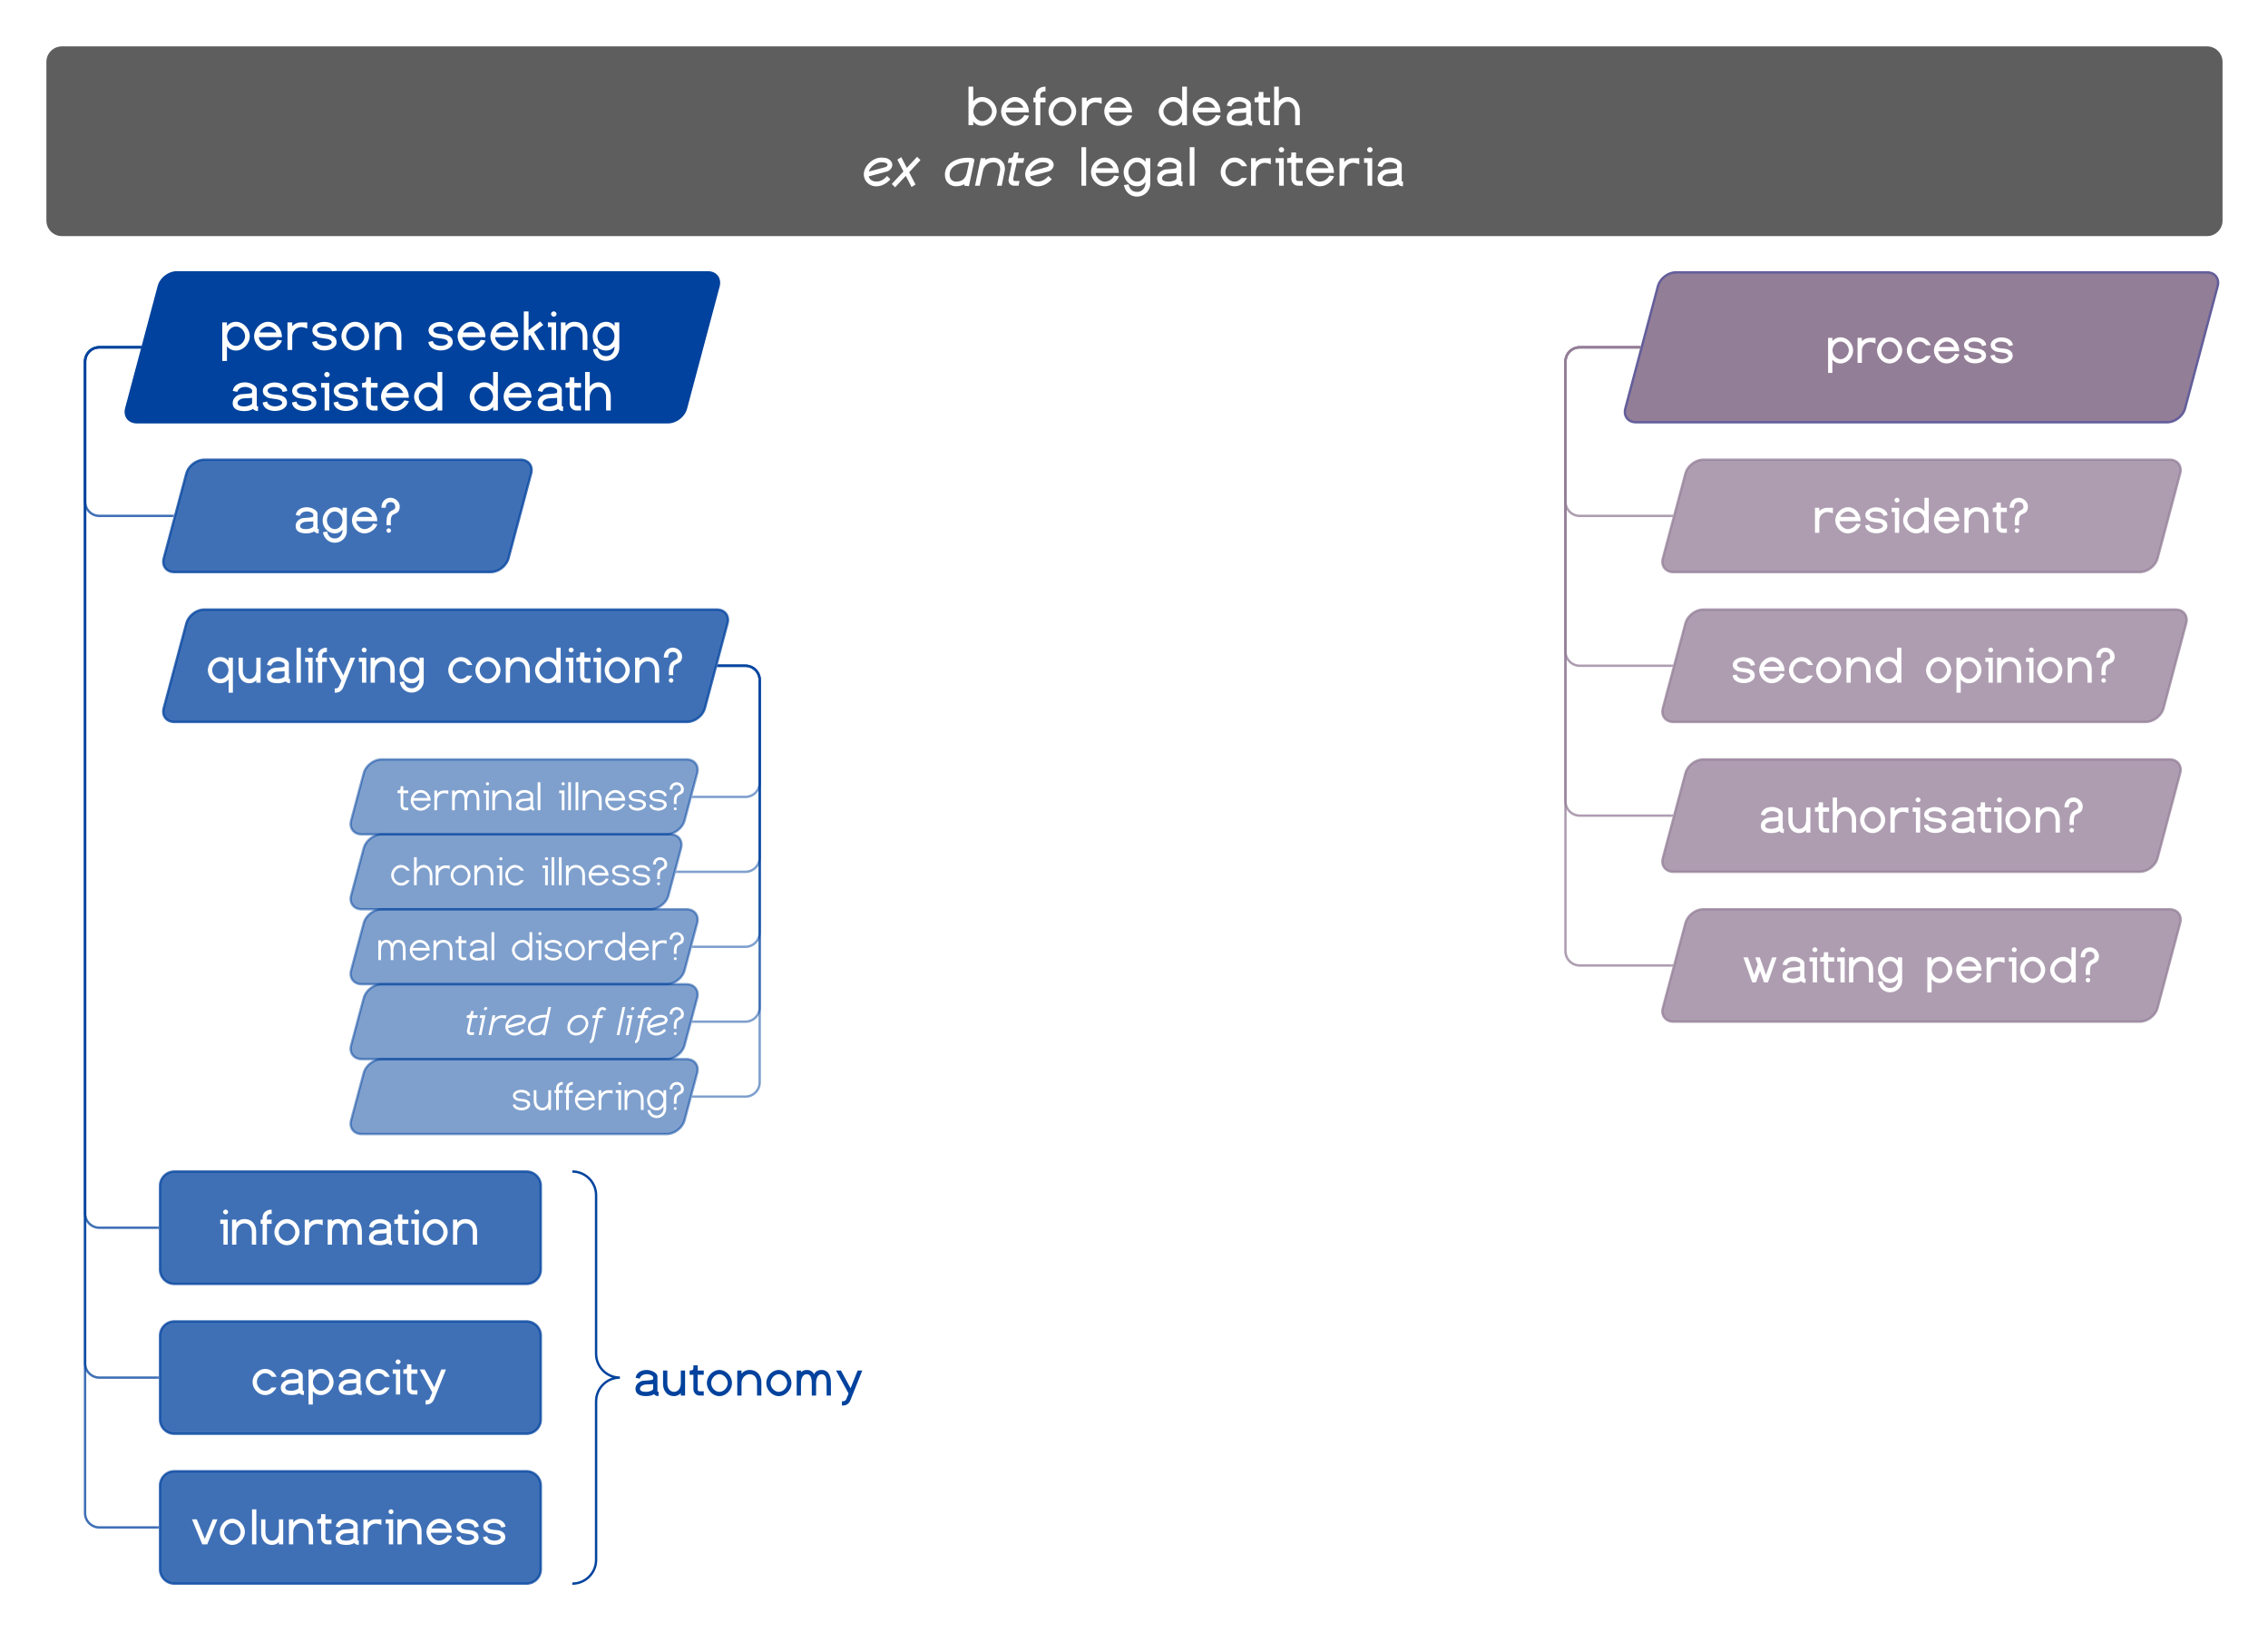
assisted death eligibility criteria narrow sense

Slide 5
eligibility criteria unpacked autonomy
information
  possessing relevant facts about one’s situation
    eg prognosis, alternatives, what assisted death consists in
legal (decision-making) capacity
  using information to choose in accordance w/personal values
  Capacity and Self-Determination (Jersey) Law 2016
voluntariness
  freedom from influence on values (coercion, undue influence)
  freedom from interference w/knowledge (manipulation)

Slide 6
eligibility criteria unpacked age
most jurisdictions restrict assisted death to adults
some jurisdictions permit assisted death for minors
  eg Netherlands, Belgium
considerations for minor assisted death
  standard of decision-making capacity?
  parental powers?
    to veto a minor’s request for assisted death
    to consent to assisted death on minor’s behalf

Slide 7
which eligibility criteria and why? reasons for selection
‘legal eligibility criteria reflect what kinds of assisted death are morally permissible’
‘legal eligibility criteria reflect a concern for “control of the consequences” of legalising assisted death’
  law may be narrower than morals
  objective that only people who want die and who ought to receive assistance in fact have assisted death
  are narrower eligibility criteria safer?
  are narrower eligibility criteria worth trade offs?

Slide 8
summary
assisted death legal eligibility criteria
  broad sense
  narrow sense
eligibility criteria unpacked
  autonomy
  age
which eligibility criteria and why?

Slide 9
any questions?

