Slide 1
The case for change
By Dr Jacky Davis

Slide 2
Over 200 million people have access to some form of assisted dying
Jurisdictions to pass assisted dying legislation include:
10 states in America incl. Oregon, California, Hawaii, plus Washington DC
The Australian states of Victoria, Tasmania and Western Australia
New Zealand
Spain

Slide 3
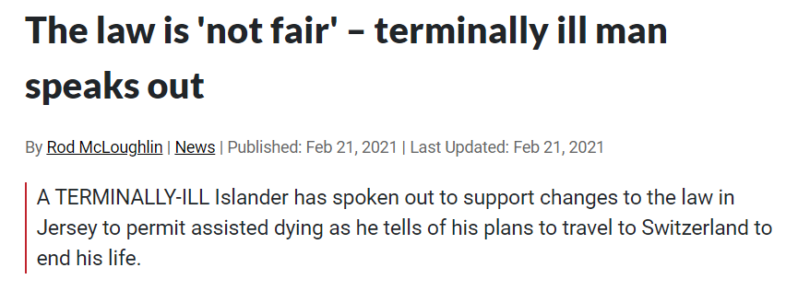
The current law doesn’t work

Slide 4
Doctors know the law isn’t working

Slide 5
Dying people are not suicidal
‘’I’m not suicidal. I don’t want to die. But I’m dying and I want to die on my own terms”
– Brittany Maynard, who had brain cancer and moved from California to Oregon to have an assisted death

Slide 6
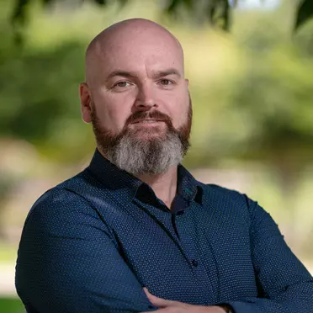
They want the choice to die peacefully
“Being present during an assisted death is nothing short of beautiful.”
– Dr. Cameron McLaren - medical oncologist, Victoria, Australia.

