Slide 1
Hospital Policy Board
Workshop 2
3rd August 2018

Slide 2
Feedback previous Workshop
    Re-cap: The need for new general hospital
4th October 2012
  CoM agreed the need for a new hospital
18th October 2012
  R125/2012 – Hospital pre-feasibility spatial assessment project: interim report, set out the case for change
23rd October 2012
  P82/2012 – Health and Social Services: A New Way Forward
  States Members accepted Do Nothing was not an option
  Ministers charged with bringing forward detailed proposals for a new hospital by 2014
“It was recognised that central to the development of the initiatives proposed was the need for a general and acute hospital which was fit for purpose, capable of sustaining the general and acute care requirements for the population and one that was embedded in the proposed new system for health and social care. It was noted that P.82/2012 indicated that a new hospital would be required within 10 years.”

Slide 3
2: Re-cap: review of sites – 2012
Officer working party
• Screened 27 potential sites against the criteria
WS Atkins
Short-list assessment
+ scoring
+costs
Warwick Farm
Existing site
Waterfront opt 2
(Aquasplash/Cineworld)
Aug
Jun-Jul
Recommendation of 13 sites for long-list assessment
Officer working party
• Screened another 11 sites
Nov
Existing site
St Saviour’s
Hospital
WS Atkins
Long-list
Assessment
+ scoring
Existing site
Waterfront
Alternative configurations assessed
May
Waterfront
Dec
Warwick
Farm
Overdale
Dec
Warwick Farm
Not considered deliverable

Slide 4
Site selection process – current site

Slide 5
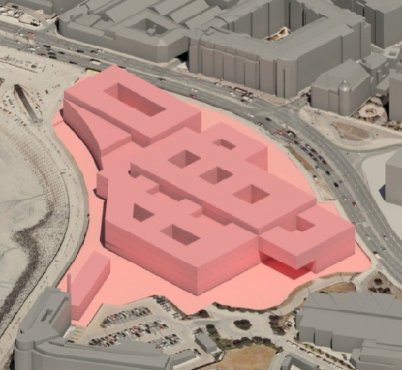
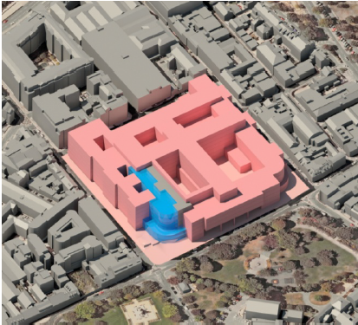
Outcome of Atkins Spatial Assessment Project
Waterfront option 4 site 14C
£432,765,000
Existing site 1E
£461,693,000
22nd February 2013 – MOG confirmed that the Existing site 1E would be the preferred site

Slide 6
Refined concept
18th June 2013
The spatial assessment project outcome and the proposed funding strategy were considered by the Ministerial Oversight Group.
Ministers requested that a refined proposal, based on the findings and recommendation of the previous proposal, but within the identified funding available, be drawn up, to inform the States Assembly of the approach to be adopted within a more detailed Feasibility Study.
“the last sitting of the States in July could receive an update on the hospital explaining that a decision had been taken to rebuild on the existing site, that CoM had accepted that a budget of £250 million would be allocated until subsequent phases were possible”

Slide 7
Refined concept
A Health Design Champion was appointed to develop a concept of a phased development which would meet the allocated budget.
In order to vacate areas of the existing site that needed to be demolished a new building at Overdale housing ambulatory care was proposed.
Many of the existing buildings on the main site were to be retained and refurbished in order to reduce costs.

Slide 8
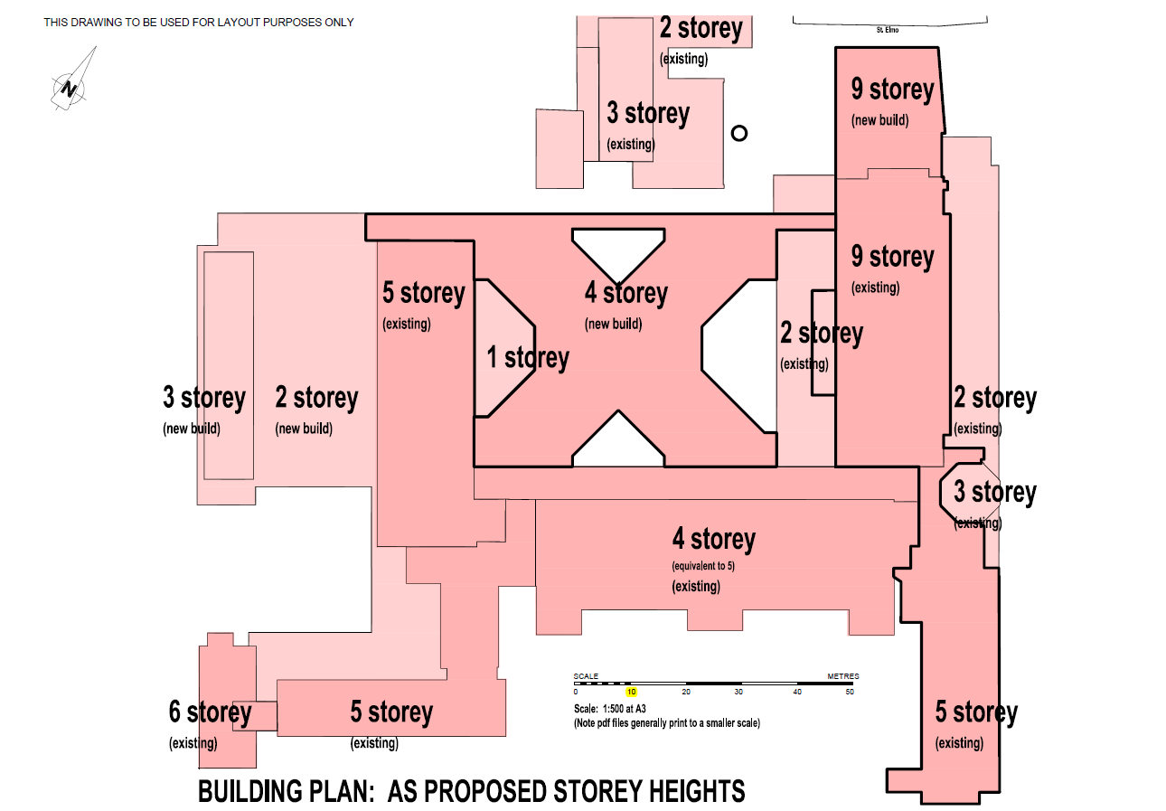

Slide 9
Dual-site concept
17th September 2013
The dual-site concept was approved by MOG.
8th October 2013
The Draft Budget Statement 2014 was lodged as a proposition. Details of the site search, dual-site proposals and a budget of £297m were included as an appendix. The budget approved £10.2m in order to progress the design development, preliminary works and transitional capacity requirements.
“This funding provides for preliminary activities that are required to enable the phased main works programme to be undertaken.
The funding will also enable the acquisition of land necessary to complete site assembly for the proposed developments and for the project team to undertake design works for the initial phases and carry out some required necessary preliminary works.”

Slide 10
Political concerns
5th September 2014
The HSSH Scrutiny Panel issued a report, SR10/2014, reviewing the transformation of Health Services.
The report raised concerns that both the public and employees were concerned about the dual-site proposal, the length of time it would take before the hospital was completed and that the States Assembly had not been involved in the decision making process.
17th September 2014
MOG agreed to accept Recommendation 12 and concluded that a stand-alone R&P was in the best interests of transparent and open Government.
Recommendation 12
“The Council of Ministers should lodge a proposition prior to the lodging of the Medium Term Financial Plan 2016 - 2019 to ask the States Assembly to decide on the site for the future hospital in order for a formal decision to be made on this issue.”

Slide 11
Site appraisal report
The Future Hospital Project Board, at special meetings attended by the Chief Executive Officer of SoJ on 25th September and 22nd October 2014, subsequently determined that a further Site Validation Exercise should be undertaken to specifically address Recommendation 12 of SR.10/2014.
6th November 2014
A new Health Minister was appointed who also had concerns about the dual-site proposal.
17th December 2014
MOG met to agree the options to be considered in a new site appraisal report to be prepared by Gleeds:
  Option A – Dual-site retained as a benchmark of the minimum investment necessary to achieve safety
  Option B – 100% new build at Overdale Hospital and adjacent land
  Option C – 100% new build on the current General Hospital site and adjacent land
  Option D – 100% new build on the Waterfront – Zephyrus/Crosslands/Jardins de la Mer
“JRi outlined that the [final] three options would be unconstrained by an agreed capital limit as this could not at this point be estimated.”

Slide 12
Site appraisal report
22nd April 2015
MOG received the outcome of the Gleeds Site Appraisal Report CR04. The report concluded that the Waterfront option scored significantly better than all other options. The dual-site option scored very poorly.
22nd July 2015
MOG requested a further review to consider additional sites of Parade Gardens and People’s Park.
Gleeds’ initial findings noted that Parade Gardens was not suitable to progress past the long-listing process but that People’s Park was worthy of further short-list assessment. This was carried out on a like-for-like basis with the other short-listed options.
An updated Site Appraisal Report CR21 was produced which concluded that the People’s Park option scored significantly better than all other options.
1st October 2015
MOG received the outcome of the CR21 report and noted it was recommended as the best performing site. It was agreed to take this recommendation to COM on 14 October.

Slide 13
Consultation
27 January 2016
COM agreed that there should be a period of public consultation in order to ascertain views on the four short-listed sites.
23 February 2016
P3/2016 was a proposal by the Constable of St Helier to remove People’s Park from the list of sites for consultation. The Health Minister subsequently confirmed its removal as a potential option.
Ministers entered a period of reflection on the project’s objectives.

Slide 14
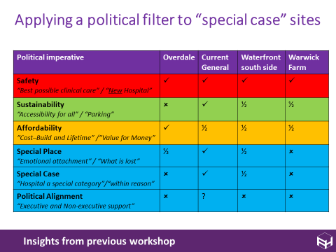
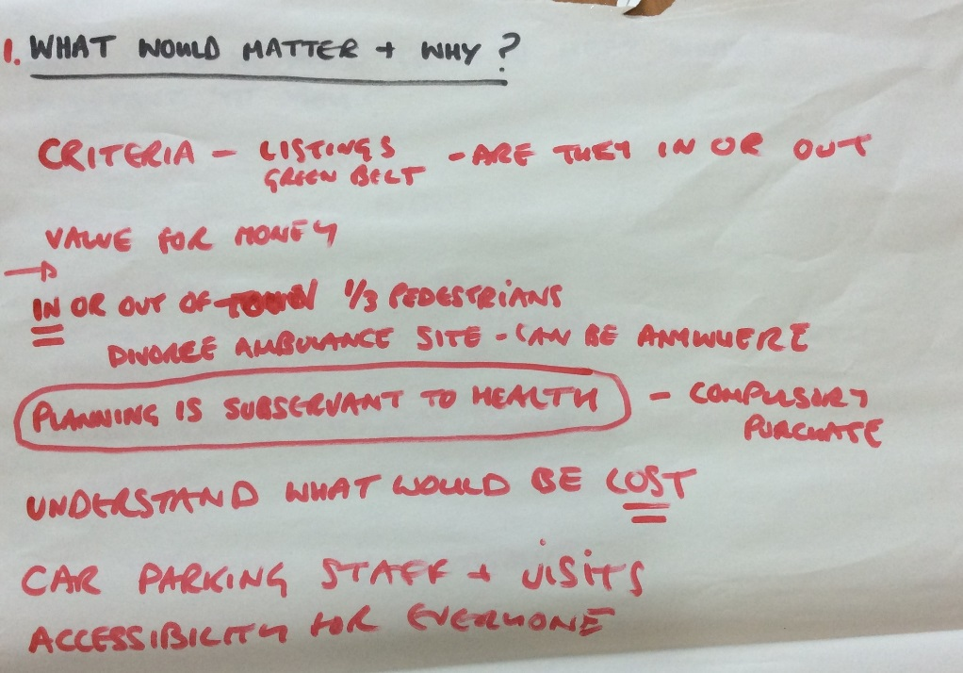
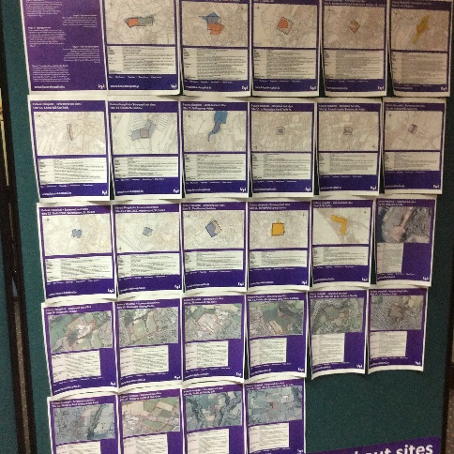
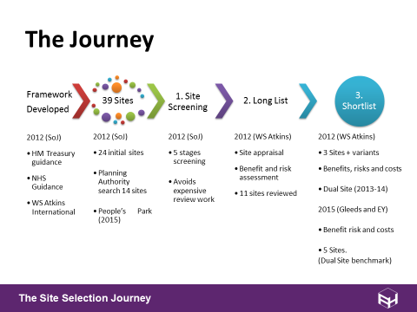

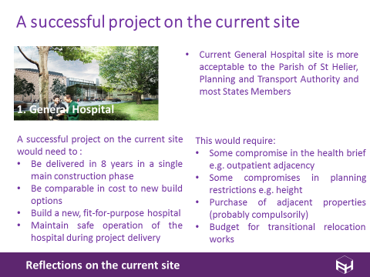
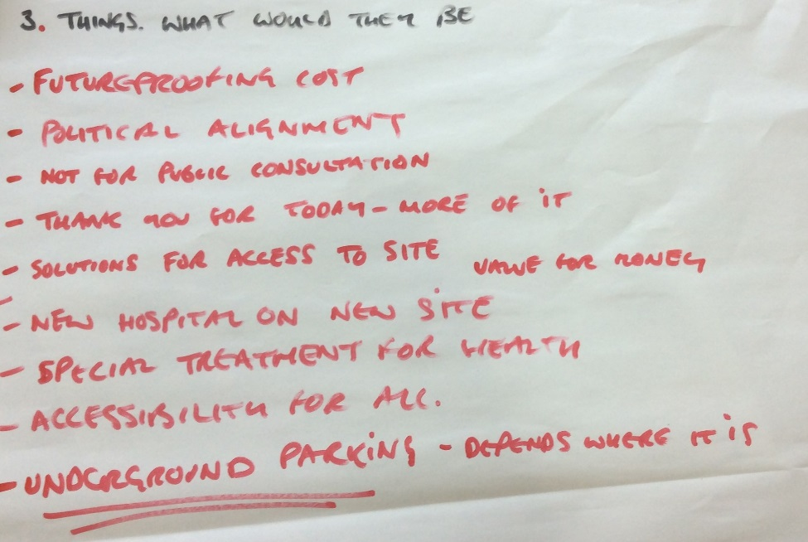
States Members’ workshops
Workshop 1 (March and April 2016)
Technical site appraisal process
Insights from States Members
Workshop 2 (May and June 2016)
A possible approach
Insights from States Members
Workshop 3 (July 2016)
Proof of concept
Addressing future challenges

Slide 15
Proof of concept
Gleeds prepared CR25 Proof of Concept report
  Could be built in a single phase
  Indicative massing
  Safe operation of the existing hospital
  Cost approx. £466m
Concept proposal discussed at POG on 12th May, 7th July and 17th August 2016
21st September 2016
Draft Report & Proposition discussed at COM

Slide 16
States Assembly
19th October 2016
Report & Proposition for building a hospital on the existing general hospital site and adjacent properties, lodged au Greffe
16th November 2016
States Members briefing with update on the proposition
1st December 2016
Debate on the preferred site
Proposition approved by States Members

Slide 17
Next steps
Board feedback
  Did it provide a sufficient view and discussion of the evidence?
Next workshop 3 - 7th August 10am-12pm
  Feedback and discussion from previous workshop 2
  Engagement Process

