Slide 1
Increasing COVID-19 threat and our need to respond
Dr Ivan Muscat
6th November 2020

Slide 2
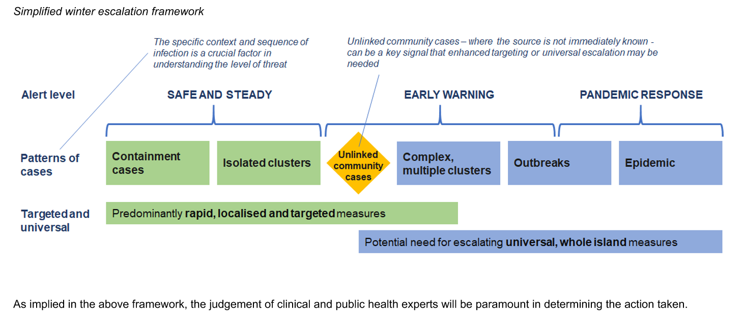
The Island is at a critical stage

Slide 3
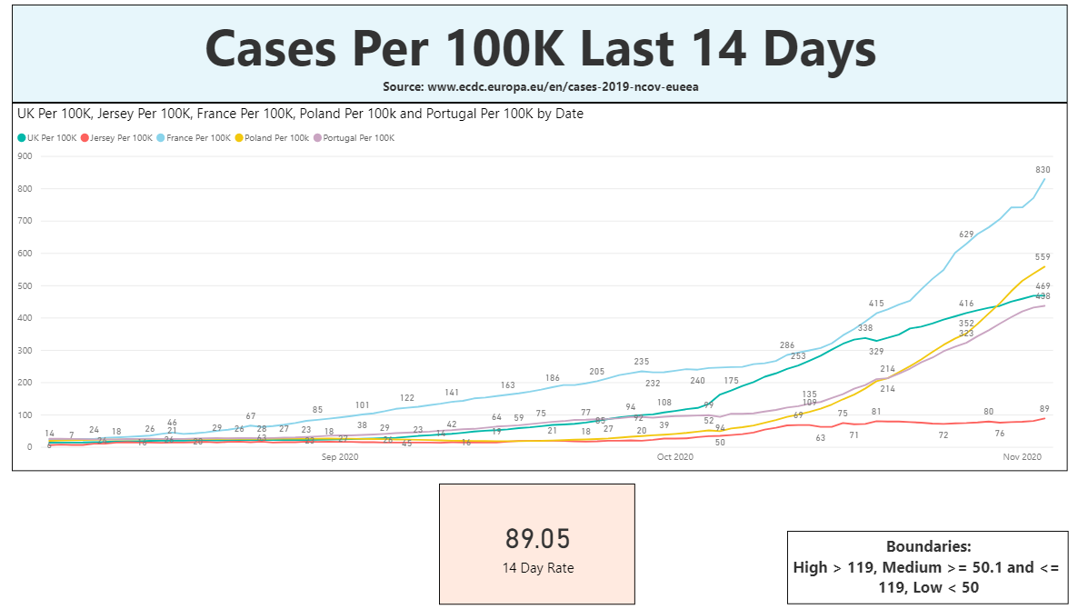

Slide 4
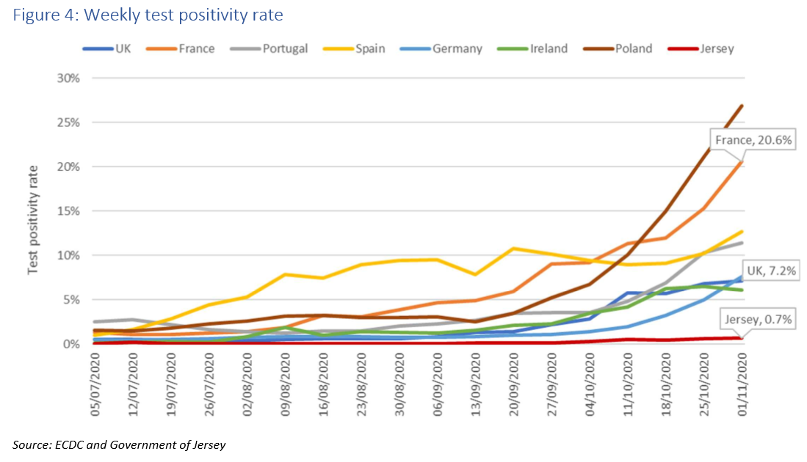

Slide 5
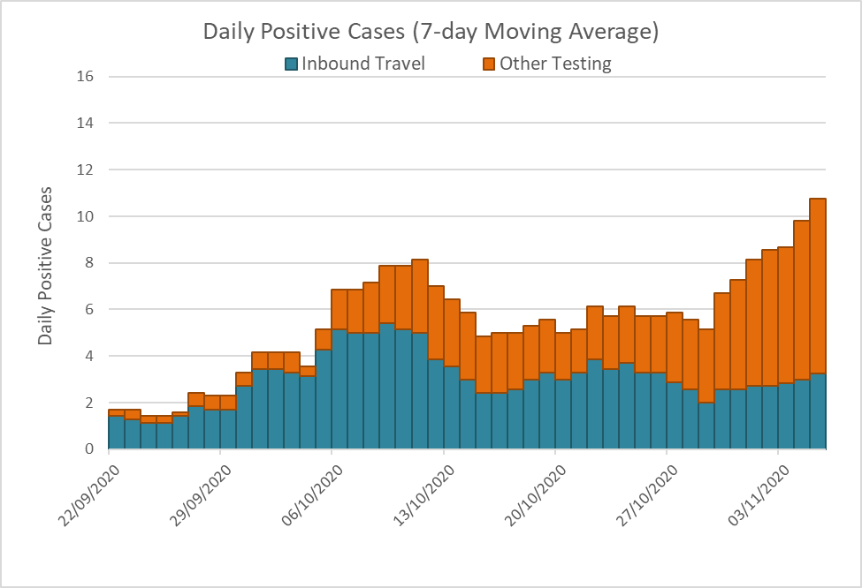

Slide 6
Incidents of unknown source
Clusters
October
Workforce dinner party / Hospitality venue
Health Care Site
November (still under investigation)
Party / Hospitality venue
Workforce social event
43+ve cases

Slide 7
Threat
Non-arrival positives > arrival positives
Non arrivals inside and outside households often in young adults in enclosed crowded close contact settings e.g. parties
Response
Make good decisions based on risk
Avoid private gatherings and events that don’t follow guidance
Balance the number of social contacts with risk
Encourage older children and young people to avoid large groups and parties
Know when and where to take actions that stop transmission
  Physical distancing
  Mask wearing
  Hygiene – handwashing, respiratory and touch points
If control is lost stronger measures will be necessary

