Slide 1
State Assisted Dying: A Dangerous Path to go Down
Dr Gordon Macdonald
Chief Executive, Care Not Killing

Slide 2
Key Points: The Dangers of Euthanasia and Assisted Suicide
A Duty to Die - pressure on vulnerable people, elder abuse, increasing numbers, euthanasia without explicit consent etc.
Slippery slope – extension to include other conditions or groups (e.g. psychiatric conditions, children).
Opposition from palliative care clinicians - changes to the medical culture and the doctor/patient relationship
The normalisation of suicide where death is seen as a solution to any form of ‘unbearable suffering’

Slide 3
Oregon: Fear of Being a Burden
(Source: Oregon Health Authority, DWD Act annual reports)
1998 13% cited this as a reason for assisted suicide
2001 24%
2004 38%
2007 44.9%
2011 42.3%
2015 48.1%
2017 55.2%
2019 59%

Slide 4
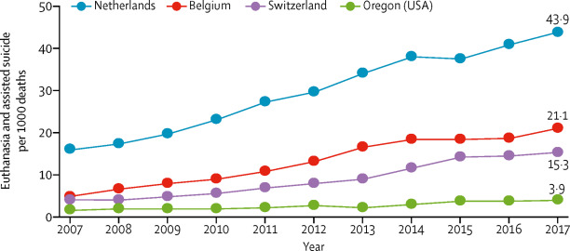
Increases in State Assisted Deaths (Source: Borasio, Jax & Gamondi, The Lancet, 20/2/19)

Slide 5
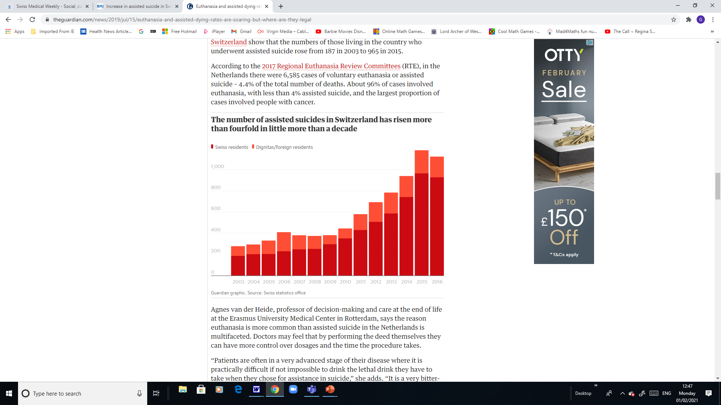
Source: The Guardian, 15/07/19

Slide 6
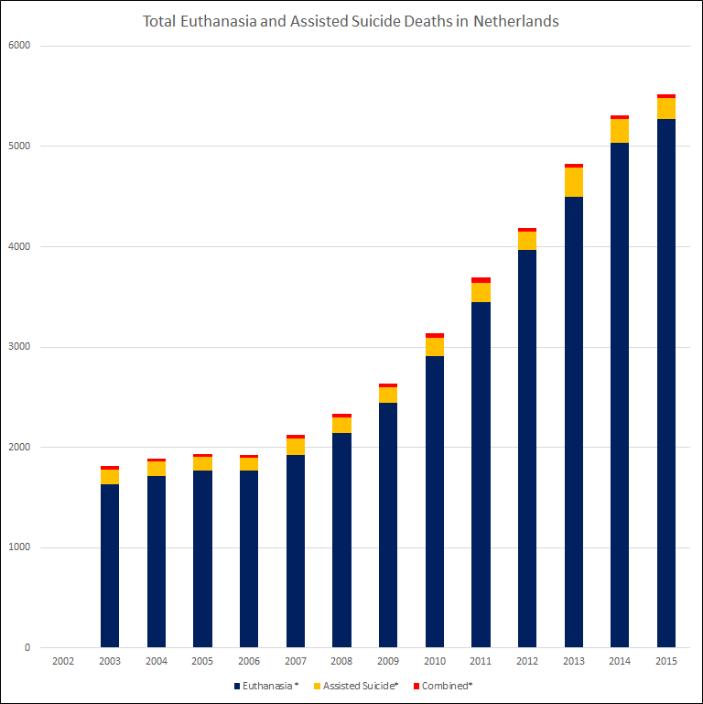
The Netherlands
4 % of all deaths are formally classified as euthanasia.
More than 25% of deaths are induced either as a result of euthanasia, assisted suicide or continuous deep sedation.
Bar chart source: Murphy S. statistics compiled from the Regional Euthanasia Review Committees' Annual Reports. Protection of Conscience Project, August, 2017.

Slide 7
The slippery slope is inevitable
Autonomy and compassion arguments can be applied widely
Logical ‘mission creep’ using equality law –extended from
- Terminally ill to chronically ill
- Adults to children
- Mentally competent to mentally incompetent
- Those with serious illnesses to elderly people who have multiple minor conditions or are just ‘tired of life’.
Proposed safeguards don’t work and aren’t safe

Slide 8
Belgium – Raus et.al. (Source: The Journal of Medicine & Philosophy, 46,pp. 80-107, 2021)
Findings:
Physicians can diagnose "polypathology"—an assortment of minor medical problems—as sufficient criteria for euthanasia of the elderly.
The treating physician can override consultants' objections to euthanasia.
The oversight Commission that monitors euthanasia has conflicts of interest and is fraught with ethical contradictions.

Slide 9
Euthanasia solely for Psychiatric Conditions in the Netherlands
2017 – 83
2016 – 60
2015 – 56 A 600% increase 2012-17
2014 - 41
2013 - 42
2012 - 14
2011 - 13
2010 - 2

Slide 10
The World Medical Association Oct 2019
“The WMA reiterates its strong commitment to the principles of medical ethics and that utmost respect has to be maintained for human life. Therefore, the WMA is firmly opposed to euthanasia and physician-assisted suicide.”
“No physician should be forced to participate in euthanasia or assisted suicide, nor should any physician be obliged to make referral decisions to this end.”

Slide 11
BMA Poll Results
76% of palliative care respondents were personally opposed to Physician Assisted Suicide (PAS).
83% of palliative care respondents were personally opposed to euthanasia.
76% were unwilling to participate in PAS
84% were unwilling to administer euthanasia

Slide 12
Continuous Deep Sedation until Death in the Netherlands
2001 – 5.6% of all deaths
2005 – 8.2%
2010 – 12.5%
2013 – 16%
2016 – 20%
2017 – 22.6%

Slide 13
The Normalisation of Suicide
Prof. Theo Boer
“The assumption that euthanasia will lead to lower suicide rates is not supported by the numbers.”
150% increase in the euthanasia rate in 10 years in the Netherlands and a 40% increase in the suicide rate from 2007 to 2016. (Journal of Ethics in Mental Health,10, Dec 2017)
In Oregon, the suicide rate increased by 35% between 2001 and 2018. In 2019, the suicide rate among the general population was 35% higher than the US national average.

Slide 14
The key arguments against euthanasia
A change in the law would place vulnerable people under pressure to request early death – therefore it should not be changed for a few persistent cases
Requests for euthanasia are extremely rare when patients needs fully met – therefore we need good palliative care
The current law is clear and right and works – it tempers justice with mercy

