Slide 1
The Policy Inclusion Framework
Images courtesy of Learning Disability Service (NHS Leeds)

Slide 2
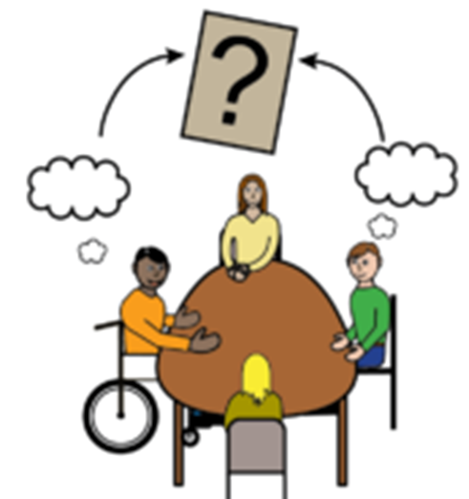
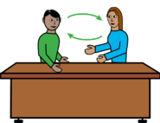
As the Government of Jersey, we want to find out the best way to listen to people in Jersey and get their feedback.
How we listen and talk to people is called ‘engagement’.

Slide 3
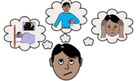
We want to get feedback on problems facing the Jersey community.
We come up with solutions and want to hear what you think of them.
These solutions are called ‘policies’.

Slide 4
By listening to what you think of our policies, we are checking that the policies work for you.
Listening to you helps us understand the problems you face. This means we can create better solutions for you.

Slide 5
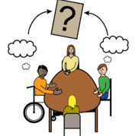
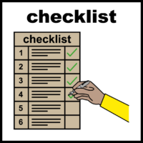
We have created a tool to improve how people in Government listen to the public. The tool helps us to understand when we need to listen to people, and how we can do it.
This tool is called The Policy Inclusion Framework.

Slide 6
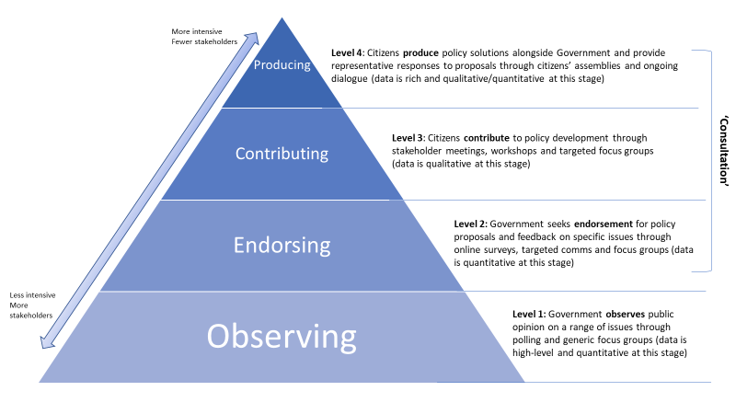
The Framework looks like this:

Slide 7
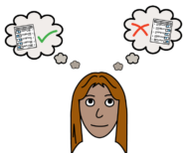
What does the Framework say?
The Framework says that we should listen to people all the time to understand what is most important to them.

Slide 8
The Framework says that we should give people the chance to have their say and help us come up with policies.
The Framework says that Government should find out what people think in different ways. This includes polling, surveys and meeting with people.

Slide 9
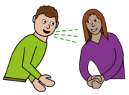
The Framework says we need to make it as easy as possible for people to have their say. This means:
We need to go out into the community more.
We need to make it easy to come to meetings if you have a disability.
We need to translate things if you don’t speak English as your first language.

Slide 10
The Framework talks about doing more polling and more citizen’s assemblies.
Polling is when the Government sends a survey to lots of people. The survey asks what problems are the most important to you right now.
This helps us understand what problems we need to focus on.

Slide 11
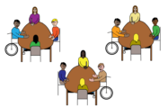
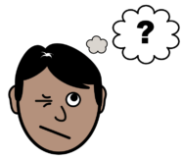
A citizens’ assembly is a group of people from the community. They have meetings to learn and talk about a problem.
They tell the Government what we should do about the problem.
This is for complicated problems like climate change.

Slide 12
Tell us what you think.
How would you like the Government to listen to you?
Tell us by filling out this short survey.
You can also email policyengagement@gov.je and tell us.

